Slide 1



Introduction to GitHub Copilot
GitHub Copilot Basic Features
Exploring AI assistance in coding workflows
by RocketMind academy
Notes:
AI-generated content may be incorrect. --- GitHub Copilot is an AI-powered code completion tool that assists developers by suggesting code snippets and entire functions. In this presentation, we will explore its features, benefits, integration with development environments, and how to get started with it.

Slide 2







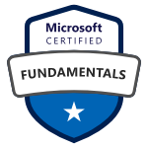

RocketMinders
www.linkedin.com/in/luismanez
www.linkedin.com/in/rubentg
luis.manez@outlook.com
rtoribiogallardo@gmail.com
github.com/luismanez
github.com/Rtoribiog
twitter.com/luismanez
twitter.com/Rtoribiog
Luis Mañez
Ruben Toribio
RocketMind Academy CTO
RocketMind Academy CEO
Azure AI + M365 Development MVP
AI Expert / Full stack developer

Slide 3
01
Getting Started with GitHub Copilot Chat

Slide 4
Copilot Chat
Copilot Chat Panel
Access : Open via shortcut : Ctrl + ALT + I (Windows/Linux)
Toggle secondary sidebar: Ctrl + Alt + B
Use Cases :
Ask natural-language questions (e.g., "Explain this function" )
Multi-file context analysis for complex tasks.
Quick Chat (Inline Interactions)
Right-Click Menu :
Select code blocks → "Ask Copilot" for targeted suggestions
Quick Fix :
Use Ctrl + I (Windows)

Slide 5
Copilot Chat
Code Suggestions & Navigation
Trigger Suggestions :
Start typing → Inline suggestions appear automatically.
Cycle Through Suggestions :
Next: Alt + ] (Windows) or Option + ] (Mac).
Previous: Alt + [ (Windows) or Option + [ (Mac)
Accept/Reject :
Accept: Tab.
Reject: Esc, Backspace, or scroll away

Slide 6

General Software Questions
Understanding Node.js
Node.js is a runtime environment that allows developers to run JavaScript on the server-side, providing efficiency and scalability.
“Tell me about Node.js web server frameworks.”
Creating an Express Application
Express is a minimal and flexible Node.js web application framework that provides a robust set of features for web and mobile applications.
“How can I create an Express app?”
Managing npm Packages
npm is a package manager for JavaScript and helps manage project dependencies, allowing easy updates and installations.
@terminal How to update an npm package?” (uses the @terminal chat participant )

Slide 7

Code Generation
Requesting Code Assistance
Users can request Copilot to write specific functions or modify existing code with simple prompts.
“Write a function to sum all numbers in a list.”
Error Handling in Code
Users can enhance their code by asking Copilot to add error handling features to existing functions.
“Add error handling to this function.”
Interactive Code Responses
Responses include interactive options to copy, insert, create a new file, or run the code directly.
“@workspace Add form validation, similar to the newsletter page.”

Slide 8

Security Alerts & Fixes
Fixing Security Alerts
Understanding how to address security alerts effectively is crucial for maintaining secure codebases.
“How would I fix this alert?”
Identifying Code References
Finding the specific line of code referenced in an alert helps pinpoint the issue quickly and accurately.
“Which line of code is this code scanning alert referencing?”
Dependabot Alerts
Understanding which libraries are affected by Dependabot alerts helps in managing dependencies effectively.
“What library is affected by this Dependabot alert?”

Slide 9

Project Setup
Rapid Project Scaffolding
Utilize slash commands for quick setup of various projects, enhancing efficiency and productivity.
/new react app with TypeScript
Directory Structure Suggestions
Copilot provides intelligent suggestions for directory structures, streamlining the organization of your projects.
/new python django web application
Jupyter Notebook Setup
Easily create Jupyter notebooks to analyze datasets and visualize data using libraries like Seaborn.
/newNotebook retrieve the Titanic dataset and use Seaborn to plot the data

Slide 10
Code Refactoring & Fixes
Improving Existing Code
Evaluate and enhance the quality of existing code by applying best practices and optimizing for performance.
“How would you improve this code?”
Translating Code to C#
Understand how to effectively translate code snippets into C#, ensuring functionality remains intact.
“Translate this code to C#.”
Error Handling Techniques
Implement error handling mechanisms in functions to manage exceptions and maintain application reliability.
“Add error handling to this function.”
Using the /fix Command
Utilize the /fix slash command to automatically resolve errors in active files within the coding environment.

Slide 11

Test Writing
Unit Testing Basics
Unit tests are essential for ensuring code quality and functionality. They help identify issues early in the development process.
/tests
Using Jest Framework
The Jest framework simplifies the testing process in JavaScript, providing an easy-to-use interface for writing and running tests.
/tests using the Jest framework
Test-Driven Development (TDD)
In TDD, developers write tests before the actual code, focusing on the desired functionality and ensuring quality from the start.
/tests ensure the function rejects an empty list
“Add tests for a JavaScript function that should sum a list of integers.”

Slide 12
Visual Studio Code-Specific Queries
Debugging Node.js Apps
Learn how to debug Node.js applications effectively using Visual Studio Code, enhancing debugging skills.
“@vscode Tell me how to debug a Node.js app.”
Changing Color Themes
Explore how to customize the color themes in Visual Studio Code to improve your coding environment.
“@vscode How do I change my Visual Studio Code colors?”
Modifying Key Bindings
Find out how to change key bindings in Visual Studio Code for a more personalized coding experience.
“@vscode How can I change key bindings?”

Slide 13

Command Line Assistance
Using Terminal Commands
The terminal participant allows users to execute shell commands efficiently, enhancing productivity.
“@terminal Find the largest file in the src directory.”
Finding Files
Commands like finding the largest file illustrate practical usage of terminal commands for effective file management.
“@terminal #terminalLastCommand to explain the last command and any errors.” (uses the #terminalLastCommand variable)
Explaining Commands
Using variables like #terminalLastCommand, users can get explanations for previous commands and troubleshoot errors.

Slide 14
02
Advanced Prompt Features

Slide 15
Chat Participants
@workspace : Contextual help for your project.
@terminal : Command-line assistance.
@github : Access GitHub-specific skills (e.g., web searches).
@vscode : Visual Studio Code guidance.
Manually specify participants by typing @ followed by the name. Copilot may also automatically infer the best participant based on your query

Slide 16
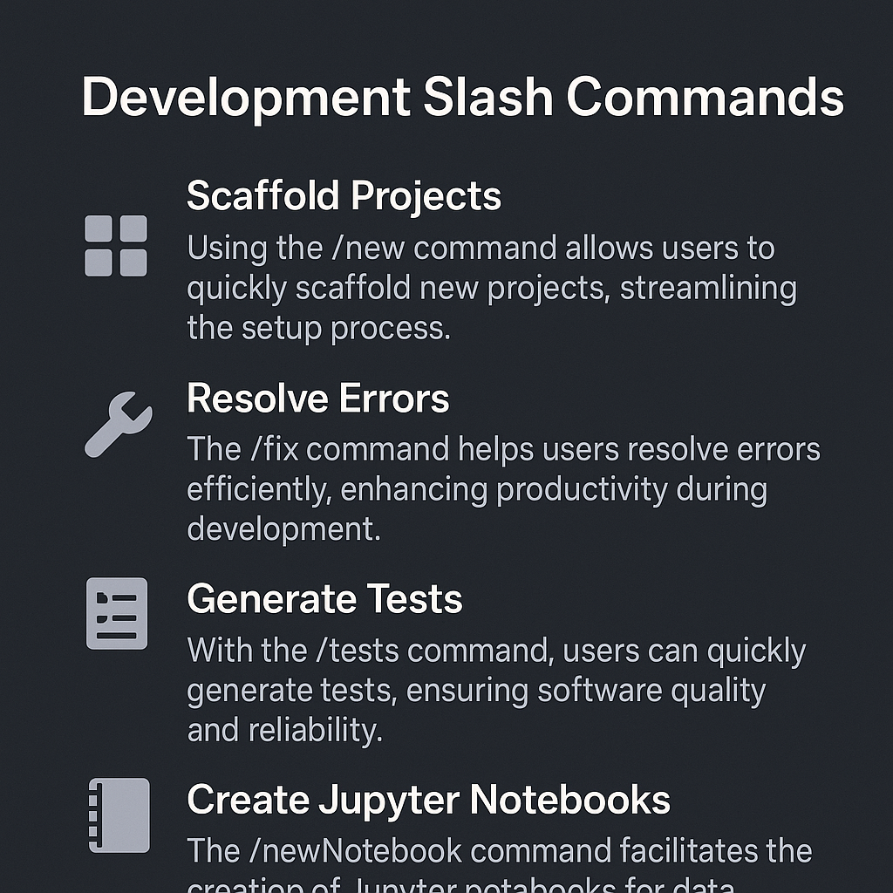
Slash Commands
Scaffold Projects
Using the /new command allows users to quickly scaffold new projects, streamlining the setup process.
Resolve Errors
The /fix command helps users resolve errors efficiently, enhancing productivity during development.
Generate Tests
With the /tests command, users can quickly generate tests, ensuring software quality and reliability.
Create Jupyter Notebooks
The /newNotebook command facilitates the creation of Jupyter notebooks for data analysis and visualization.

Slide 17

Chat Variables
File Specification
Use the # name of file or folder variable to specify the file in context, enhancing clarity in communications and documentation.
Code Selection
The #selection variable allows for the inclusion of highlighted code, making discussions more precise and focused.
Project Context
The #codebase variable provides context of the entire project, facilitating a comprehensive understanding during discussions.
Git History
The #git variable provides access to Git history and branch information, essential for tracking project changes and collaboration.

Slide 18
03
Additional Features

Slide 19

Image Support in Prompts
Image Attachment Feature
Users can now attach images in formats like JPG, PNG, GIF, or WEBP to prompts, enhancing clarity.
Explaining Code with Images
Screenshots can be used to explain code snippets, making it easier to understand programming concepts.
Explain code from a screenshot.
Generating UI Code
Mockups can be uploaded to generate UI code, streamlining the design-to-development process.
Generate UI code from a mockup.
Describing Flowcharts
Images of flowcharts or error messages can be attached to provide context for troubleshooting or explanations.
Describe flowcharts or error messages

Slide 20
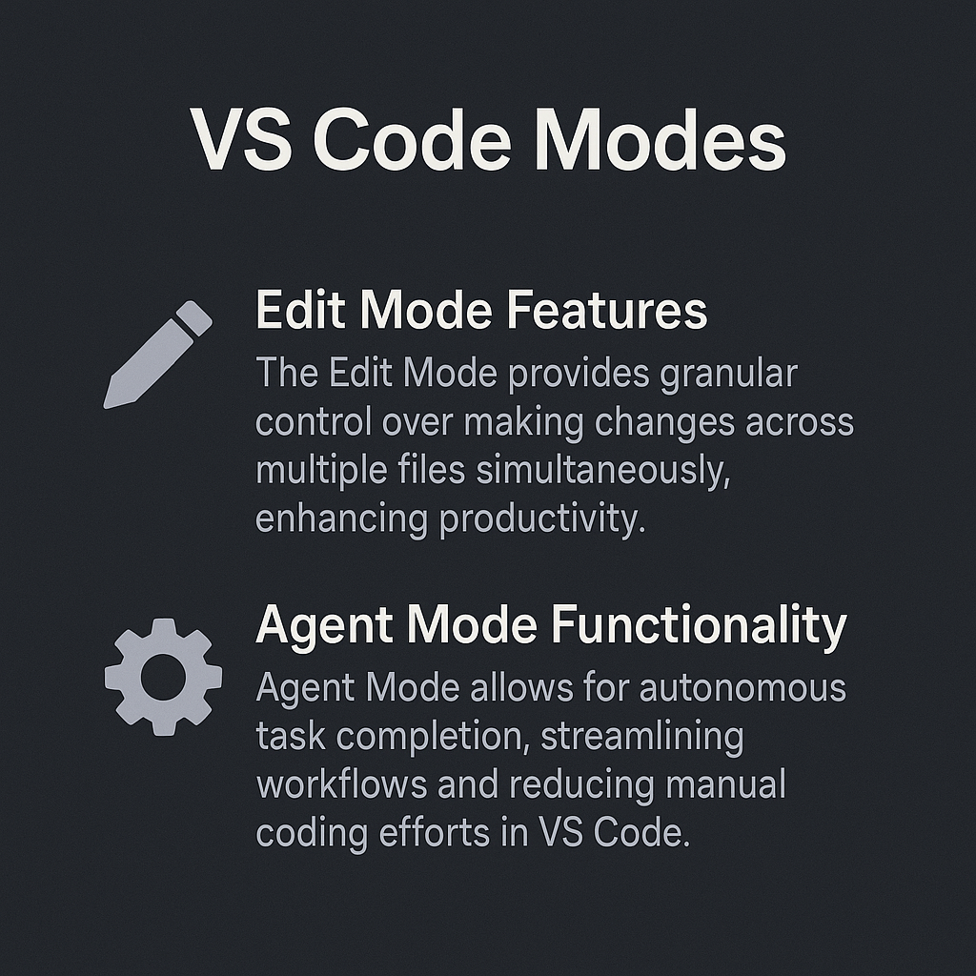
Copilot Edits
Edit Mode Features
The Edit Mode provides granular control over making changes across multiple files simultaneously, enhancing productivity.
Agent Mode Functionality
Agent Mode allows for autonomous task completion, streamlining workflows and reducing manual coding efforts in VS Code.

Slide 21

Feedback & Customization
Feedback Mechanism
Utilize thumbs up/down icons for providing quick feedback on options or features.
Custom Instructions
Enable custom instructions in Visual Studio to tailor the development environment to your needs.
Tools > Options > GitHub > Copilot

Slide 22
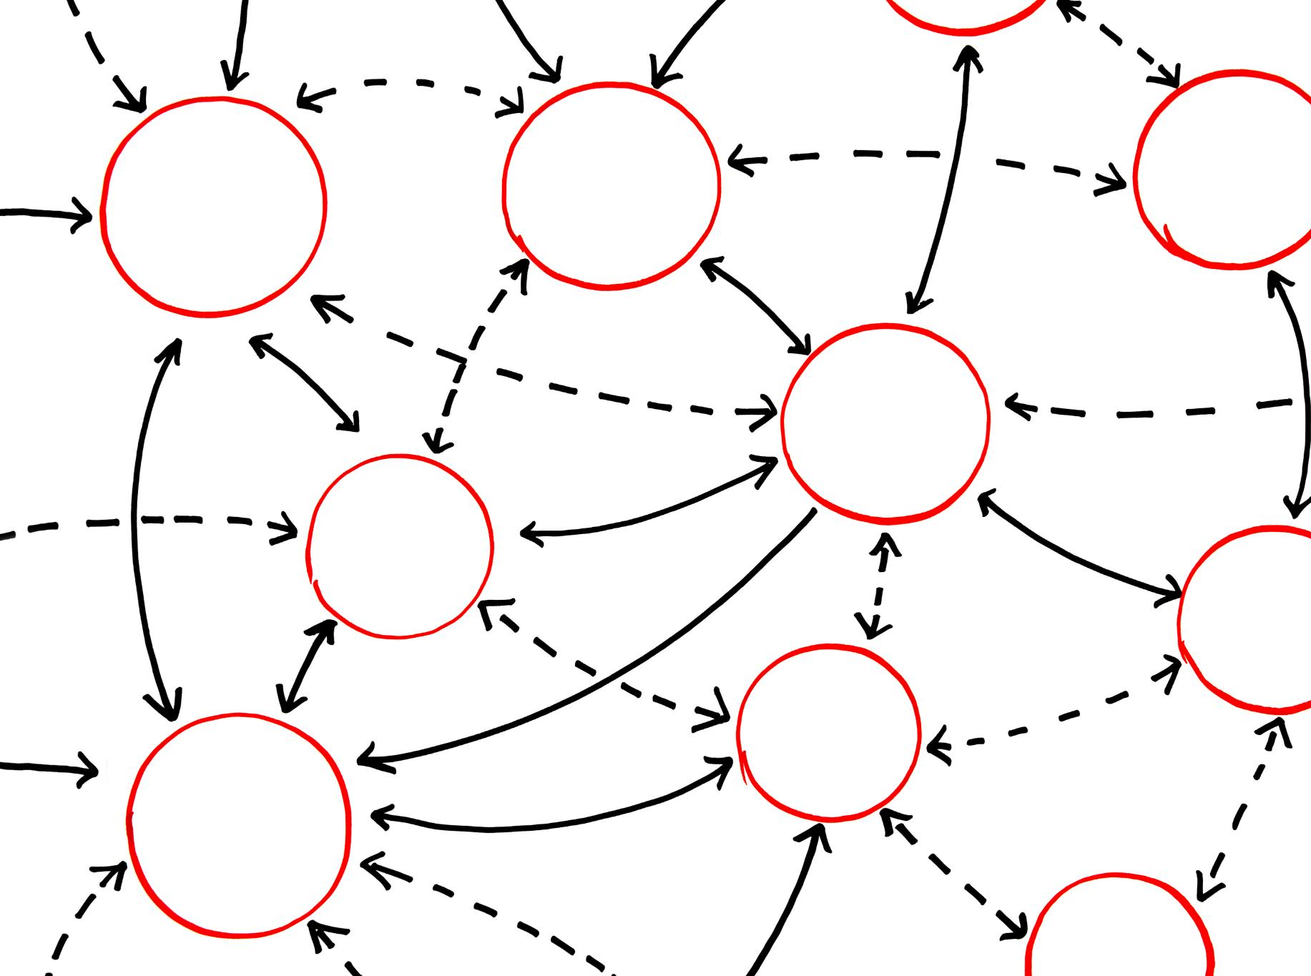
Effective Prompt Strategies
Be Specific
Providing clear and specific details in prompts helps clarify goals and expectations, leading to better responses.
Leverage Semantic Indexing
Utilizing semantic indexing allows Copilot to understand the codebase structure, enhancing the relevance of suggestions.
Iterate on Prompts
Refining prompts based on feedback from Copilot can lead to improved outputs and more accurate results.
Review Outputs
Validating the correctness and security of generated code is essential to ensure reliable outcomes.

